Slide 1
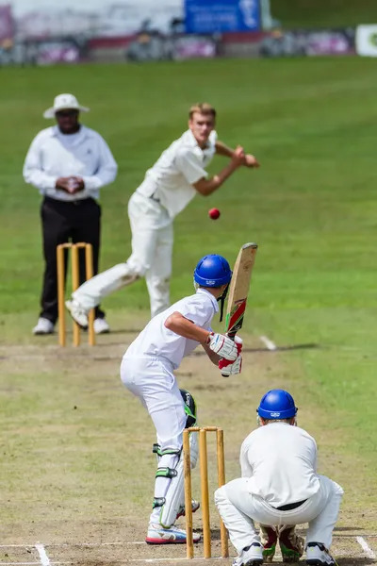
Cricket: The Game of Bat
An Informative Presentation
Author: Amey G M
Date: October 26, 2023
A Deep Dive into the Sport's History and Strategy

Slide 2
A Brief History of Cricket
Origins: Cricket's origins are debated, with evidence suggesting it emerged in South East England as early as the 16th century. Early forms were significantly different from the modern game.
Evolution: The game gradually evolved, with standardized rules and equipment emerging over centuries. Key milestones include the formation of the MCC (Marylebone Cricket Club) and the establishment of international matches.
Global Spread: Cricket's popularity expanded beyond England, taking root in countries across the British Empire and beyond, becoming a truly global sport.
Modern Era: The modern game features various formats (Test, ODI, T20), each with its own unique strategies and appeal.

Slide 3
Key Aspects of Gameplay
Batting: The batsman's role is to score runs by hitting the ball bowled by the opposing team. Techniques like defensive and attacking strokes are crucial.
Bowling: Bowlers aim to dismiss batsmen by hitting the wickets or inducing catches. Different bowling styles (fast, spin, etc.) present unique challenges.
Fielding: Fielders position themselves strategically to prevent runs and effect dismissals. Excellent fielding can significantly impact the outcome of a match.
Scoring: Runs are scored by hitting the ball to the boundary or running between the wickets. Understanding scoring methods is essential to appreciating the game.

Slide 4
Strategic Elements of Cricket
Team Composition: Selecting the right balance of batsmen, bowlers, and all-rounders is crucial for a team's success. This depends on the format and playing conditions.
Captaincy: The captain plays a vital role in setting field placements, bowling changes, and overall game strategy. Tactical decisions can significantly influence the match.
Match Situations: Adapting strategies based on the match situation (e.g., chasing a target, defending a total) is a key skill for both players and captains.
Spin vs. Pace: The choice between spin and pace bowling is a critical strategic decision, influenced by factors like pitch conditions and the batting style of the opposition.

Slide 5
Summary / Key Takeaways
Summary Points:
Cricket's origins are ancient, evolving into a globally popular sport.
Gameplay involves batting, bowling, and fielding, each with its own nuances.
Strategic elements, including team composition and captaincy, are crucial for success.
Different formats (Test, ODI, T20) offer diverse gameplay and strategic challenges.

Slide 6
Timeline of Cricket's Evolution
16th Century:
Early forms of cricket emerge in South East England.
1700s-1800s:
Standardization of rules and equipment; emergence of prominent clubs.
Late 1800s - Early 1900s:
International matches begin; Test cricket established.
Mid-20th Century:
One Day Internationals (ODIs) introduced.
Late 20th - 21st Century:
Twenty20 (T20) cricket gains immense popularity.

Slide 7
Thank You
We appreciate your time and attention

